Slide 1
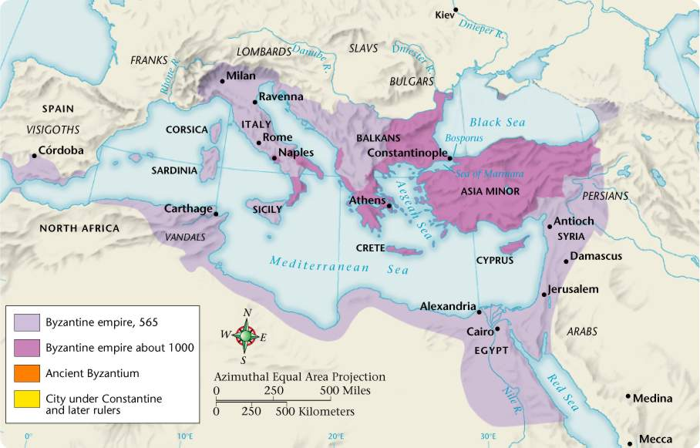
By the year 300 barbarians from the east and the north were invading and tearing the Western Roman Empire apart.
In 330 A.D. the Emperor Constantine moved the capital of the Empire east to Byzantium. He renamed the city Constantinople.
By the year 400, the Roman Empire had completely split into two parts. The Empire in the West collapsed in 476.
THE BYZANTINE EMPIRE
The Empire in the East survived for another thousand years ……

Slide 2
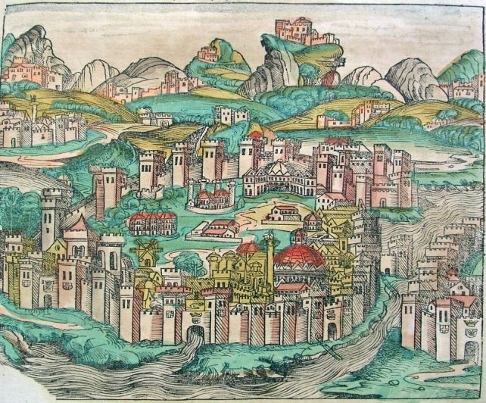
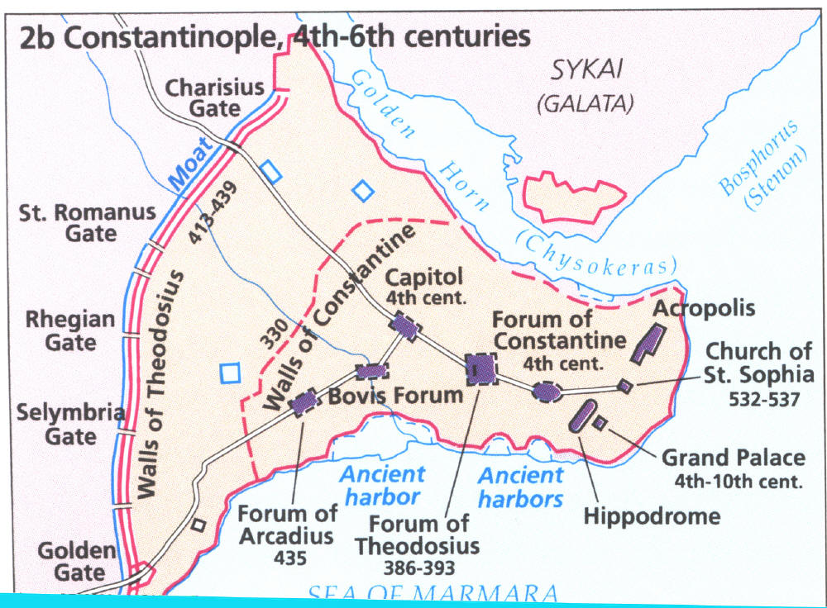
Constantinople was the vital center of the Empire
The Bosporous strait links the Mediterranean and the Black Sea
7 hills rise above the city ( like Rome! )
Excellent Harbor
Guarded on 3 sides by water
Land and sea walls

Slide 3
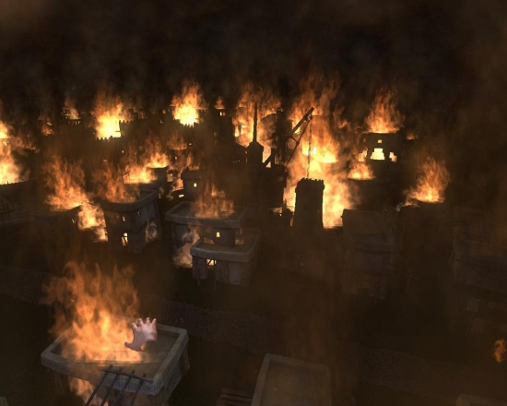
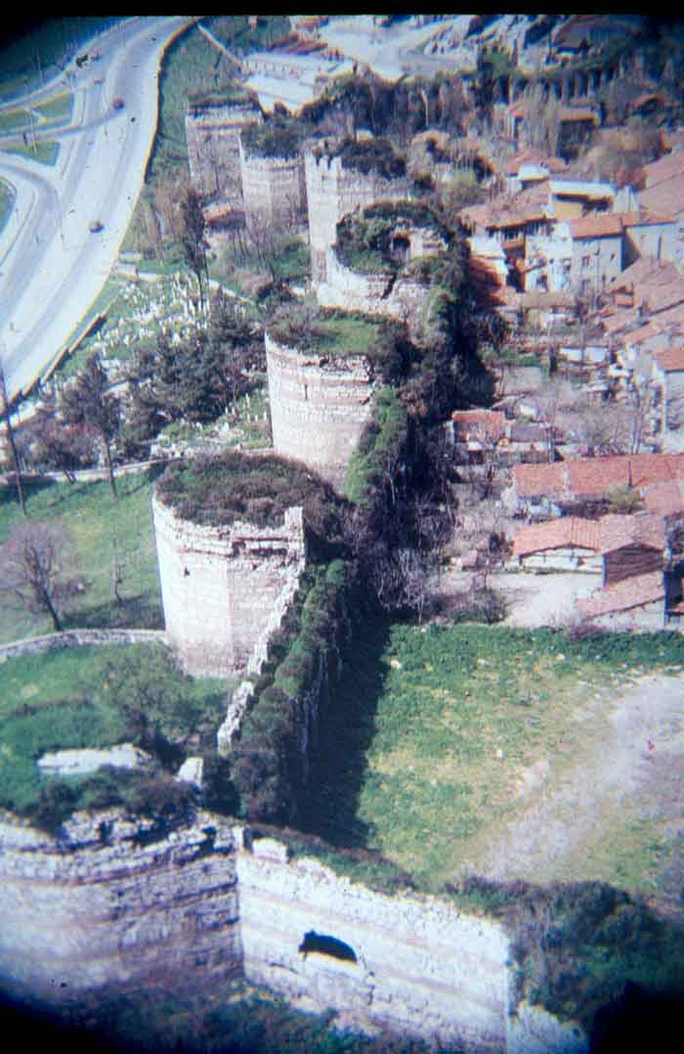

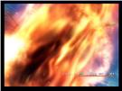
Constantinople was subject to attack from both the east and from the west
The inhabitants mounted bronze tubes on the walls of the city
When invaders attacked, “GREEK FIRE” was poured down the tubes onto the invaders
Flammable sulfur, naptha, and quicklime –liquid fire when ignited
Constantinople defeated all invaders until 1204 and was not captured until 1453

Slide 4
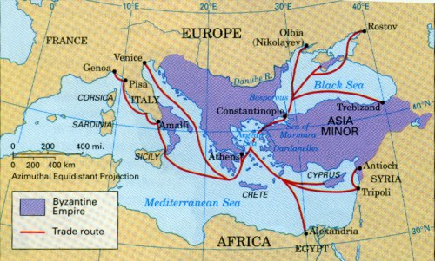
CONSTANTINOPLE – Crossroads of Europe and Asia
Connected to 3 continents by caravan tracks, rivers, seaways and roads
Traded with England, Spain, France, Africa, Russia, China and India…..
Spices, silk, minerals, wine, ivory, slaves
The Byzantine Empire Controlled Key trade routes linking Europe and Asia

Slide 5
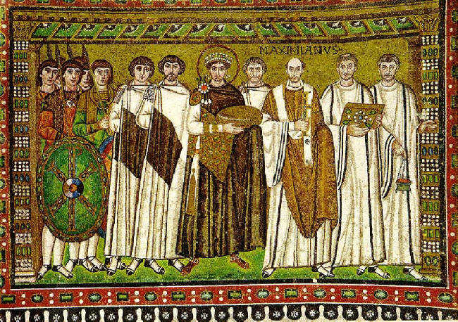
Justinian Won back many of the lands of the former Roman Empire
  Re-conquered North Africa, Italy and Southern Spain
  However – The Expenses Exhausted the Treasury and Weakened Defenses in the East
The Byzantine Empire reached its greatest size under Justinian (527-565)

Slide 6
Justinian’s scholars revised Roman Law and created Corpus Juris Civilis - this Code of Justinian influenced many western legal codes – even today
Devout and Determined
Ruled as an autocrat Emperor=Absolute Ruler Christ’s co-ruler on Earth
Considered Byzantium’s most ambitious ruler – Head of Church and State

Slide 7
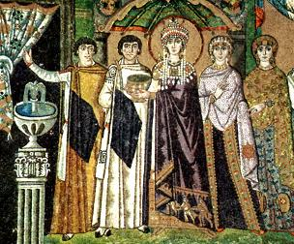
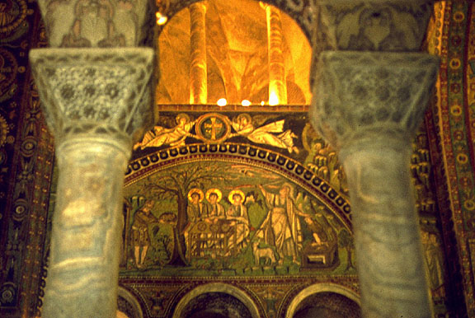
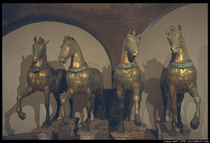
Justinian’s Dream was to create a great Christian Empire - With the help of his wife THEODORA he launched a program to beautify Constantinople and restore Roman Glory

Slide 8
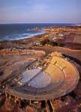
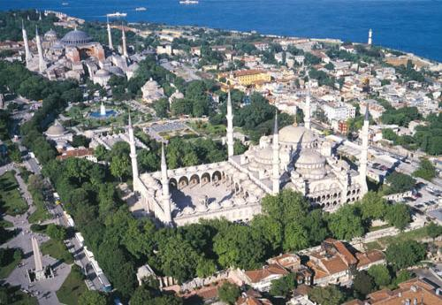
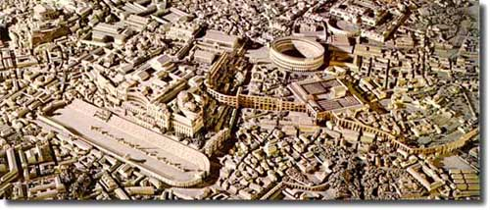
Justinian built bridges, hospitals, libraries, parks, churches and entertainment such as theaters, coliseums, and the hippodrome

Slide 9
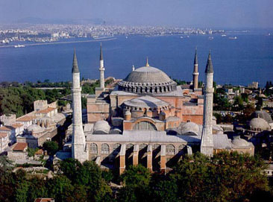
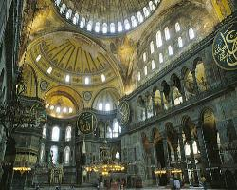
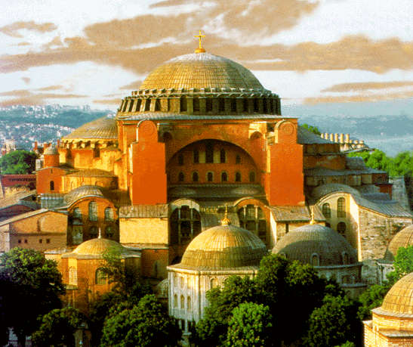
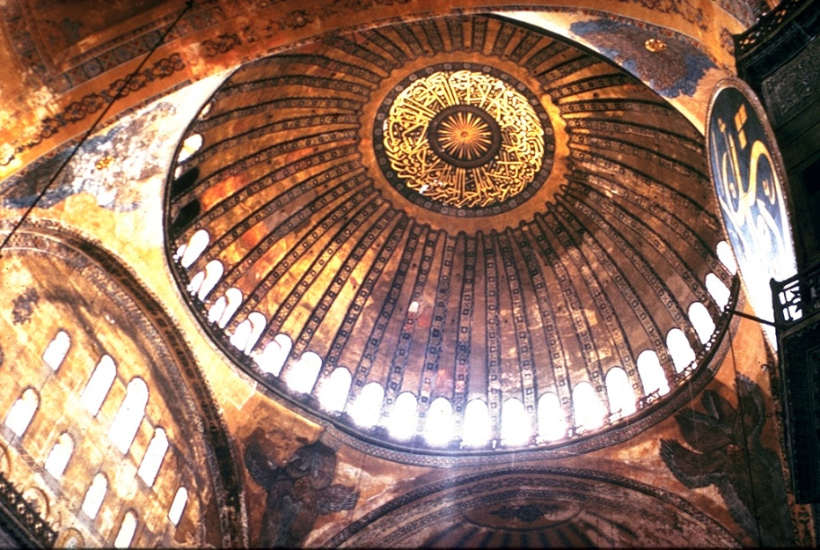
Hagia Sophia - Church built by Justinian in Constantinople
Windows made arching dome appear to “float” – colored marble, embroidered silk, mosaics
Justinian’s crowning glory – an architectural masterpiece!
“Glory to God who has judged me worthy of accomplishing such a work as this…O Solomon, I have surpassed you!” Justinian

Slide 10
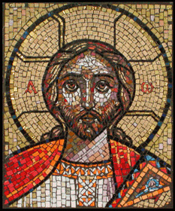
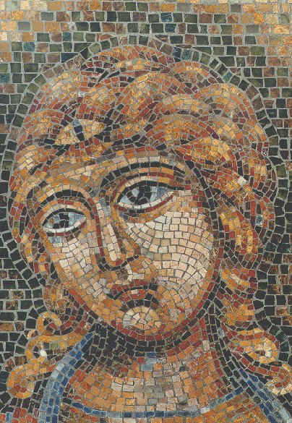
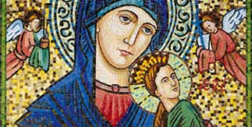
MOSAICS were made of small tiles, glass or gems - they decorated the walls of churches, palaces and the homes of the wealthy - they were the greatest artistic accomplishment of the Byzantine Empire

Slide 11
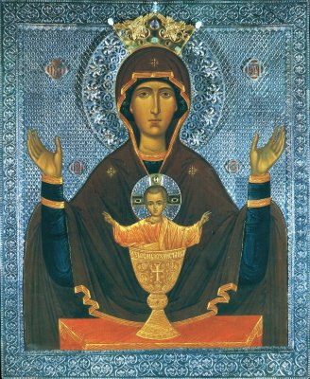
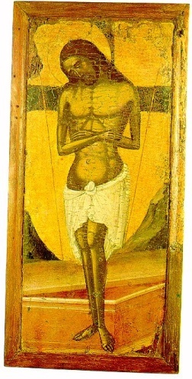
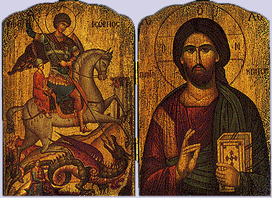
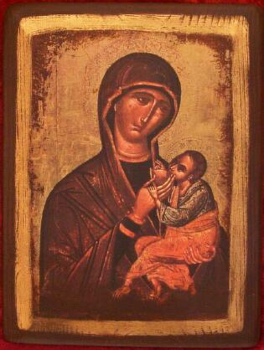
ICONS
Icons were an important aspect of Religious Art in the Byzantine Empire. Many people could not read and they would learn about the Bible from the pictures. They felt safer and closer to God.
Icons are Pictures of Important Christians or sacred events. They take the form of murals, mosaics, or wooden panels

Slide 12
ICONS
Icons were used – many disapproved
Icons were to be respected
HOW THE GREAT SCHISM HAPPENED
Pope controlled church affairs
Clergy prohibited from marrying
Latin was the language of the church
Christmas was the main holy day
Byzantine Emperor controlled church affairs
Clergy allowed to marry
Greek was the language of the church
Easter was the main holy day
Christians used Icons because few people could read
Some disapproved of showing devotion (praying) to icons
Controversy raged for years
In 1054 the Christian Church split into 2 churches
Orthodox Church
EASTERN or GREEK ORTHODOX
ROMAN CATHOLIC

Slide 13
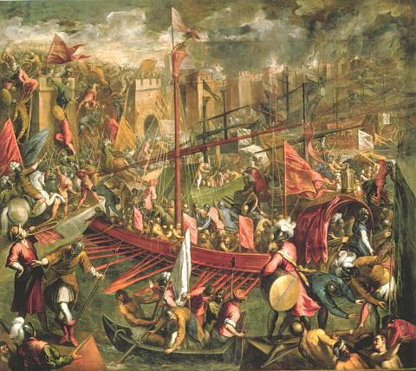
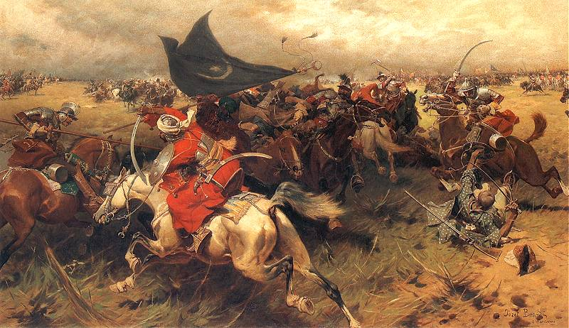
The Byzantines fought constant battles against Muslims, Arabs and Turks
They were threatened by tribes from the North
They even had to fight against Crusaders from the West who were supposed to be on their side!

Slide 14
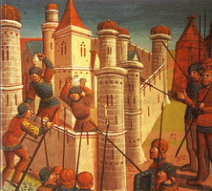
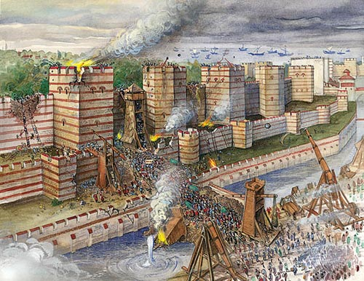
After Justinian’s death the Empire became smaller and smaller – and by 1400 only the land around Constantinople was left
In 1453 an army of OTTOMAN TURKS attacked the city and after 6-8 weeks the city fell – and the Empire Collapsed

Slide 15

For 1,000 years, the Byzantines built on the culture of the Hellenistic world. Byzantine civilization blended Christian beliefs with Greek science, philosophy, arts, and literature.
extended Roman achievements in engineering and the law.
artists made unique contributions that influenced western styles from the Middle Ages to the present.
scholars preserved the classic works of ancient Greece. They also produced their own great books, especially in the field of history.

Slide 16
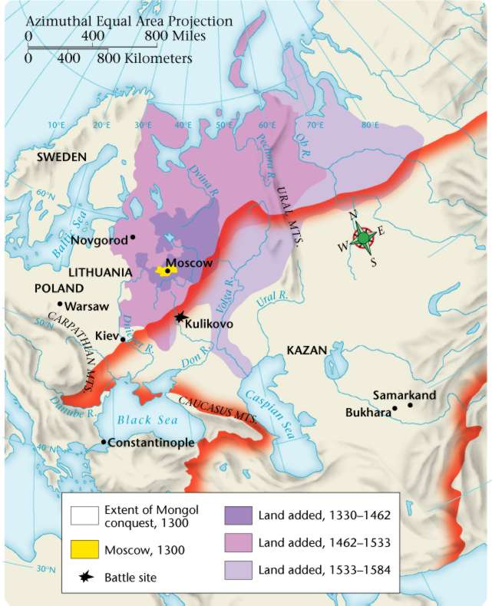
The History of RUSSIA
KIEV – the first Russian State
A network of rivers provided transportation for both people and goods.
Major rivers ran north to south, linking Russia to the Byzantine world in the south.
The city of Kiev was located at the heart of the vital trade network linking Vikings, Slavs, and Constantinople.

Slide 17
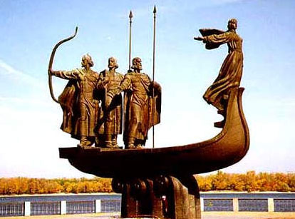
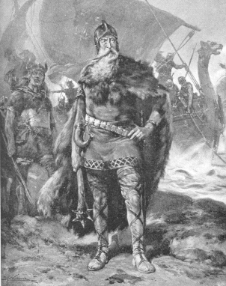
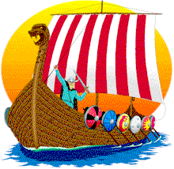
In the 800s A.D. the Vikings, under the Rule of a chief called RURIK, unified the Slavic villages and established KIEV, the first Russian State.
For 700 years Russian Rulers considered themselves descendents of RURIK (The Rus)

Slide 18
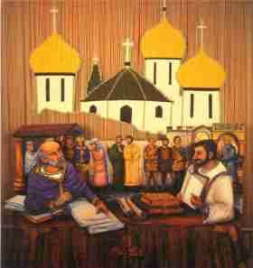
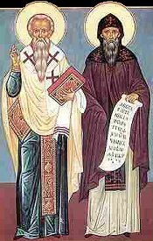
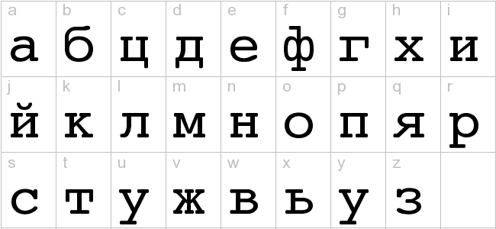
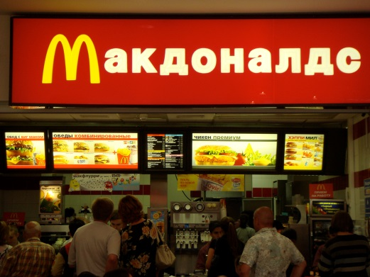
The Cyrillic Alphabet: Tailor-Made for Slavic Languages
In 861 the Byzantine Church sent Christian missionaries to convert the Slavs
Two Greek monks, Cyril and Methodius, who knew both Slavic and Greek, to translate the Bible and liturgy.
"We don't understand Latin or Greek. Please send us someone to teach us in our language."
The Cyrillic alphabet became the written script used in Russia even today

Slide 19
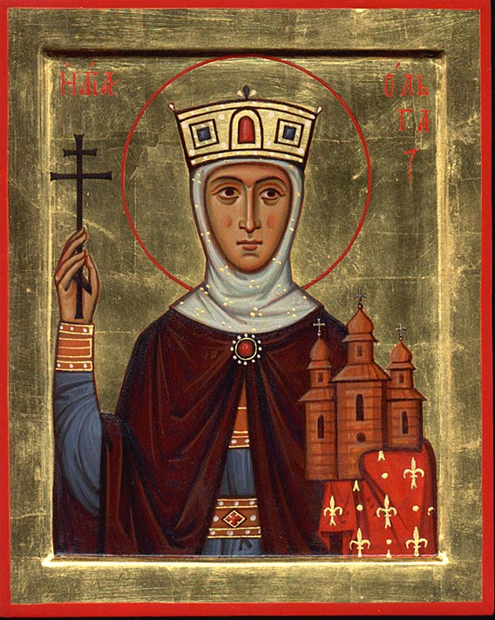
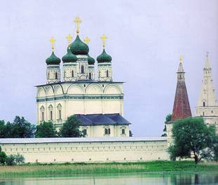
Russians adapted Byzantine religious art, music and architecture (Byzantine domes became the onion domes we see on Russian churches)
Russian rulers controlled the church
Eventually broke away into the Russian Orthodox Church

Slide 20
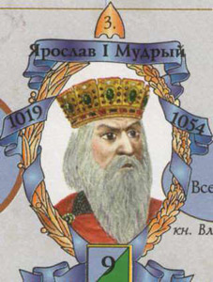
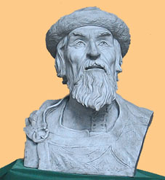
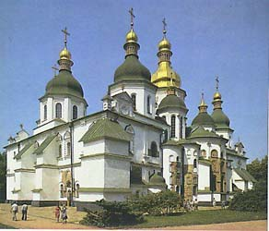
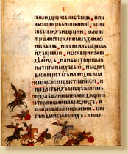
KIEV’s GOLDEN AGE – YAROSLAV the WISE
Issued written law code to improve justice
Translated Greek works into Cyrillic language
Arranged marriages between his children and royal families of Poland , Norway, Hungary and France
Beautified Kiev to copy the queen city Constantinople – built Saint Sophia

Slide 21
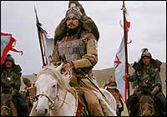
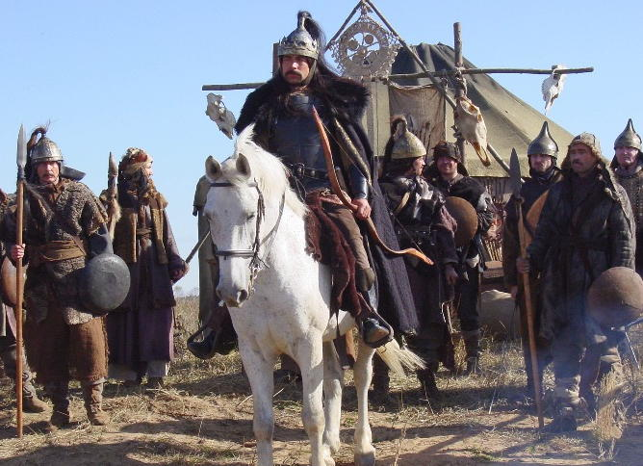
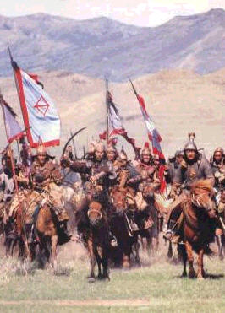
In the early 1200s, Mongol armies, led by Ghengiz(s) Khan, conquered Russia. The Mongols ruled Russia for 240 years. The dark ages for Russia
Golden Horde = the Mongol armies that invaded Europe in 1237 and ruled Russia for more than two centuries

Slide 22
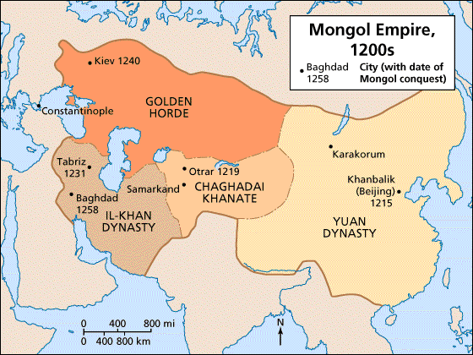
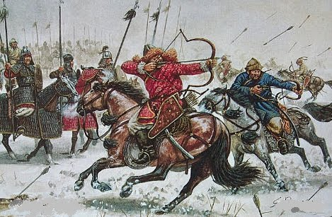
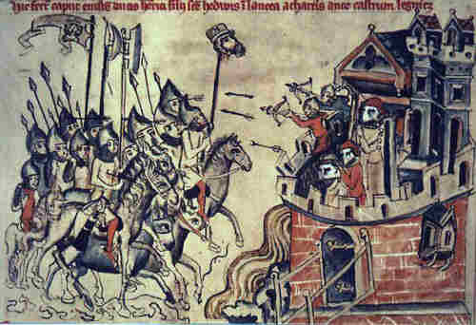
Kiev and other Russian towns were destroyed.
Many Russians were killed.
The Mongols (Islamic) tolerated the Russian Orthodox Church, which grew more powerful.
Russians adopted Mongol practice of subjugating women – husbands could even sell their wives to pay off debts!

Slide 23
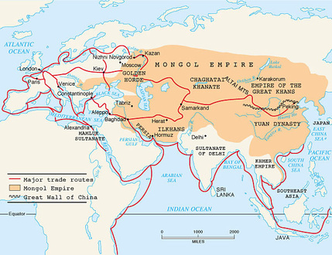
Trade routes opened up between China and Eastern Europe.
Absolute power of the Mongols served as a model for later Russian rulers.
Russia was cut off from Western Europe at an important time – Europeans were making rapid advances in the arts and science – Russia was left behind!

Slide 24


In 1378 the Muscovites defeated the Mongols – Mongols burned Moscow to the ground 2 years later
Not until the late 1400s were the Muscovites able to throw off Mongol rule
For two centuries there had been no east-west trade –communication was difficult (language barrier)

Slide 25


During the reign of the Ivans, IVAN THE GREAT married Sophia Paleologue, niece of the last Byzantine Emperor
Ivan adopted the double headed eagle and many other court ceremonies of the Byzantines
He even claimed to be the legitimate successor of the Roman Empire –
Proclaimed Moscow to be the third Rome
The prince of Moscow was to become the nation’s TSAR (Czar)– the title is derived from the Latin Caesar –
The Tsar is the Russian Head of State

Slide 26


Ivan the Terrible – grandson of Ivan the Great – further centralized Royal Power - and expanded borders
He Granted land to nobles in exchange for military or other service
Introduced new laws to tie serfs to the land
By 1560, Ivan was increasingly unstable – he even killed his own son in a fit of rage
By the time of his death in 1584 – Russia was seething with rebellion
Introduced Russia to a tradition of extreme absolute power

Slide 27

Lies between Germanic Central Europe and Slavic Russia
Includes Balkan Peninsula (Greece,Bosnia,
Croatia, etc.)
Impacted by Byzantine Empire and Ottoman Muslims
Northern region closely linked to Western Europe
The Shaping of Eastern Europe

Slide 28



Ethnic group = group of people who share same language and cultural heritage
Balkan peninsula had a lot of cultural diversity
Christianity
Islam
Judaism
Many different Languages and Customs

Slide 29


Jewish Expulsions
Throughout much of Europe the Jews were persecuted:
  Limited types of jobs they could hold
  Curfews
  forced to live in separate areas (ghettos)
  Special dress or markings
  Physical abuse and murder

Slide 30

Jewish Expulsions
Between 1100 and 1500 Jews were expelled from England, France, Spain and Portugal.
Many Jews settled in more tolerant Muslim regions and Eastern Europe.
They brought many skills and knowledge to these areas.

Slide 31




1) Magyars rule Hungary
Mongols overran in 1241, killed half of population
2) Ottoman Turks conquered Hungary in 1526
3) Southern Slavs established Balkan Kingdom of Kosovo in the 1300s
Magyars
Mongols

Slide 32




Battle of Kosovo 1389: Ottoman Turks attack -the Serbs fought to the death
This memory remains with their descendents today – 600 years later! Still a cause of great conflict.

